Slide 1
CS513
Homework 3 Satellite/Aerial Image Retrieval
Professor: Xin Chen
Group Member: Shujun Zhang A20306899,
Chen Xu A20377739

Slide 2
Outline
OVERVIEW
INTRODUCTION
Bing Maps Tile System
Mercator projection
Retrieving QuadKey
Retrieving QuadKey Matrix(Bounding Box)
Obtaining level which has highest resolution
Downloading and stitching all the tiles
APPROACH
EXAMPLE/RUN THE PROGRAM
RESULT
REFERENCES

Slide 3
OVERVIEW
The main objective is to develop a program to automatically download an aerial imagery from Bing imagery rest service for a given latitude / longitude bounding box using the Bing Maps Tile System.

Slide 4
INTRODUCTION
Bing Maps Tile System
The projection, coordinate systems, and addressing scheme of the map tiles are collectively called the Bing Maps Tile System.

Slide 5
INTRODUCTION
Mercator projection
It’s a conformal projection- preserves the shape of relatively small objects.
It’s a cylindrical projection- north and south are always straight up and down, and west and east are always straight left and right.
Use the spherical form to simplify the calculations.

Slide 6
INTRODUCTION
Retrieving QuadKey
To optimize the indexing and storage of tiles, the two-dimensional tile XY coordinates of Bing map tile system are combined into one-dimensional strings called quadtree keys, or “Quadkeys” for short.
Retrieving quad key requires 3 steps
Converting given lat, lon to pixels
Converting pixels to tiles
Converting tiles to qudakey
All the three methods are referred from Microsoft Bing map tile system documentation

Slide 7
INTRODUCTION
Retrieving Quadkey Matrix(Bounding Box)
Quadkey matrix represents a group of tiles in a map which comes under over required bounding box. Steps to retrieve this matrix involves
Get max tile which is on top left of bounding box using input 1
Get min tile which is on bottom right of bounding box using input 2
Tile 1 has max longitude and min latitude
Tile 2 has max latitude and min longitude
An Iterator function is written to calculate all the remaining tiles in between max y value to min y value with respect to max X value to min v value
The polynomial is converted to matrix of quadkeys with Y max rows and X max columns
Quad matrix = (YMAX) X (XMAX)

Slide 8
INTRODUCTION
Obtaining level which has highest resolution
Level is obtained by following steps:
Default level is considered as 23.
At level 23 tile 1 image is retrieved using quad key.
This image is considered as scrap image.
Iterate through every level and check if the O/P image is equal to scrap image.
Forbidden the level if they are equal.
Level where the image not equal to the scrap image is considered as best level.

Slide 9
INTRODUCTION
Downloading and stitching all the tiles:
For every key in QuadKey download its respective tile.
Each tile can be downloaded from Bing Image Rest API.
Every downloaded image is stitched or added to the final output image.

Slide 10
APPROACH
Since, we have the two input values i.e. the lat and long values, we calculate the maximum zoom level that can be attained for all the images and then this zoom level is fixed.
Now, level by level we zoom out from this maximum zoom level image and get the final image at zoom level 0.
In order to do so we take reference from Bing Map Tile systems.
Now using reference from Bing Tile Map systems,
We calculate the tileX and tileY values for which, we take into consideration the lat, long values and the maximum zoom level.
Now, using the starting and ending tile tuples we get the list of all intermediate tileX and tileY values.
Using the tileX and tileY values with the zoom level information, the quad key is calculated.
Finally, the maptiles are downloaded using these quad key values.
Then, all the maptiles are stitched together to get the final output image.

Slide 11
EXAMPLE/RUN THE PROGRAM
HW3.py:
python HW3.py <lat1,lon1,lat2,lon2>(no space)
lat1,lon1,lat2,lon2:
-the longitude and latitude of the bounding box.
-left top corner :lat1,lon1
-right bottom corner: lat2,lon2
output:
image.jpg
cutImage.jpg
Example:
python HW3.py 41.839468,-87.629517,41.831192,-87.623510

Slide 12
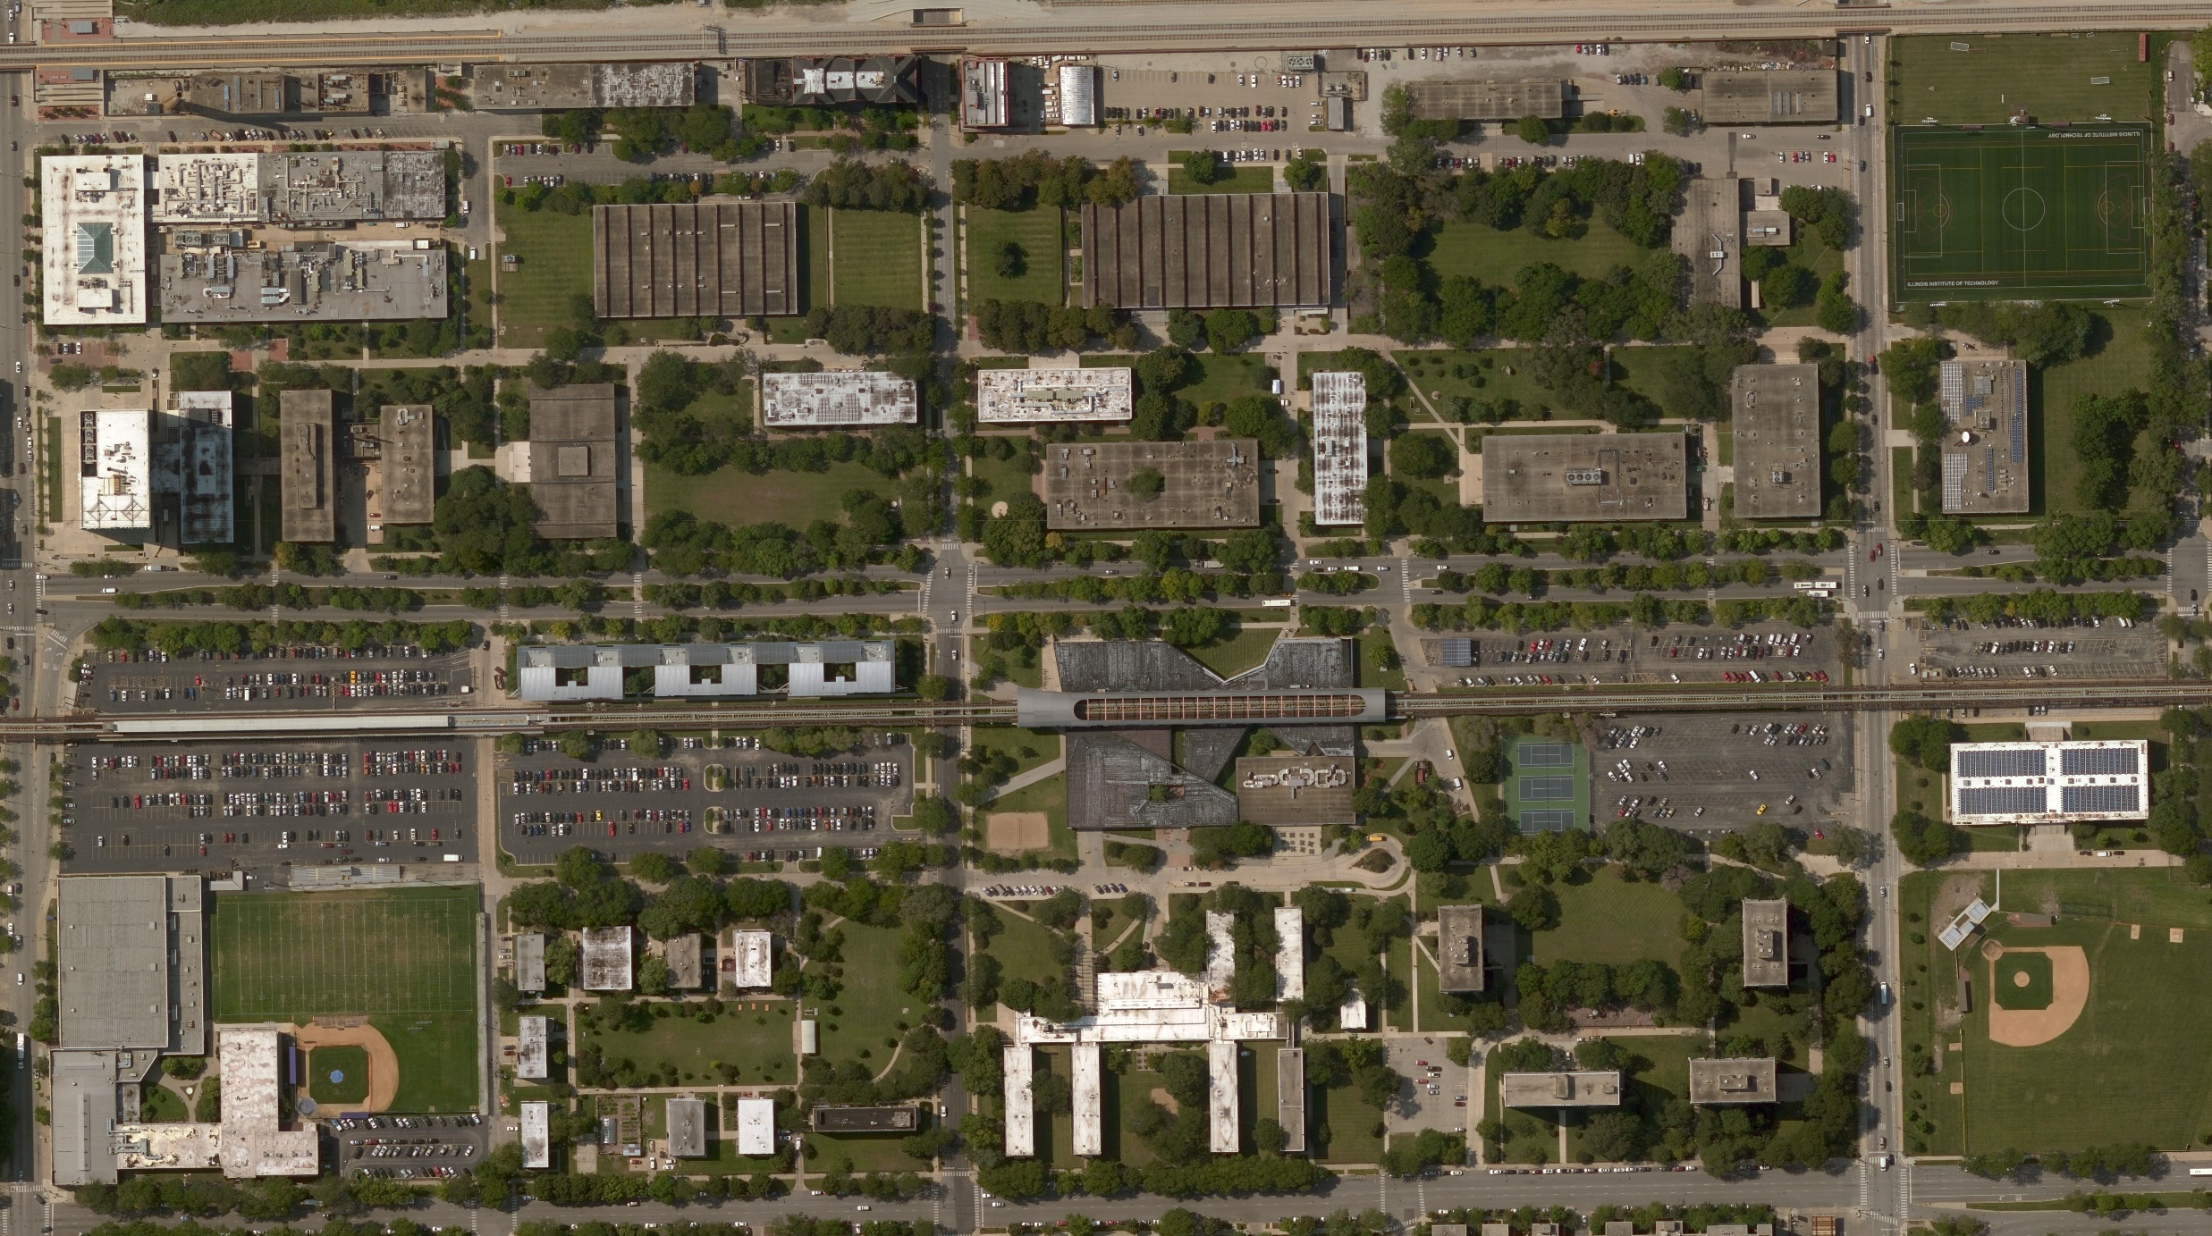
RESULT
Created Original image : image.jpg

Slide 13
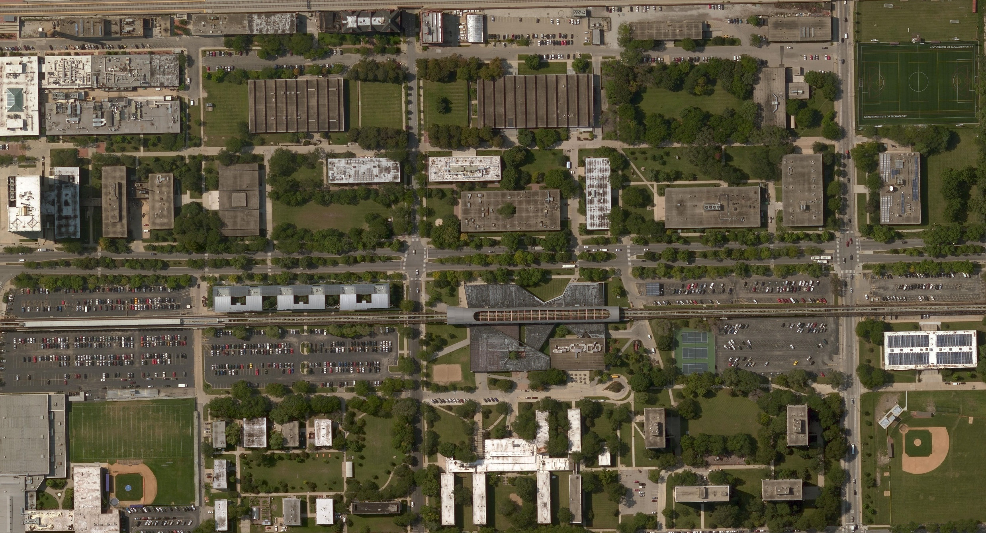
RESULT(cont)
Created Cut image : cutImage.jpg

Slide 14
REFERENCES
Bing Map Tile System “https://msdn.microsoft.com/en-us/library/bb259689.aspx”

